Slide 1
Sweetener Users Association Board Meeting April 11, 2018
Tom Earley
Agralytica
tearley@agralytica.com
105 Oronoco Street, Suite 312, Alexandria, VA 22314
703-981-6004

Slide 2
US Overview
Supply and demand are relatively balanced, although tending towards tightness.
Production up 150 tst, offsetting lower opening stocks.
Imports up due to late entry of 2016/17 TRQ increase, and lucky formula outcome on Mexican access.
Consumption rising at historic one percent pace, but numbers distorted by Hurricane Irma.
World raw prices have fallen further to 12 cents. World refined below 16 cents, pressured by EU supplies.
Refined beet at 36 cents, East Coast cane 36-37 cents. Raw sugar at 25 cents.

Slide 3
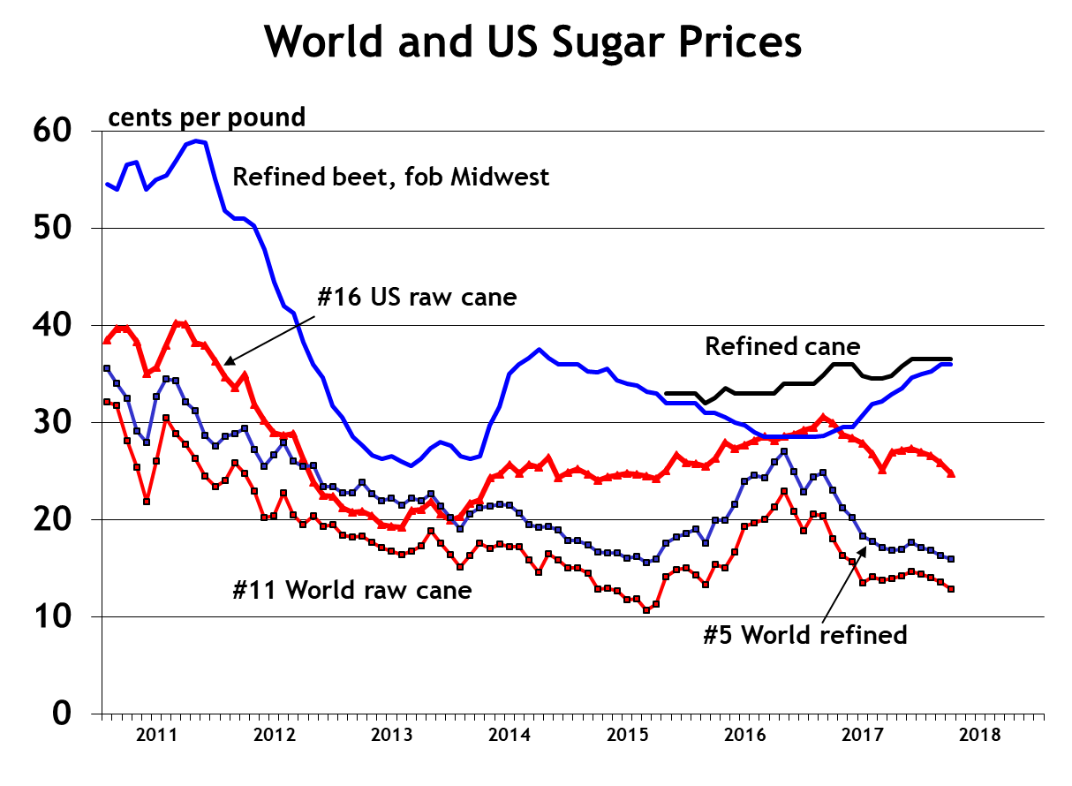

Slide 5
Good luck on the S.A. calculation this year
The extra 247,000 tons
is 2% of disappearance,
pushing S/U toward 15%

Slide 6
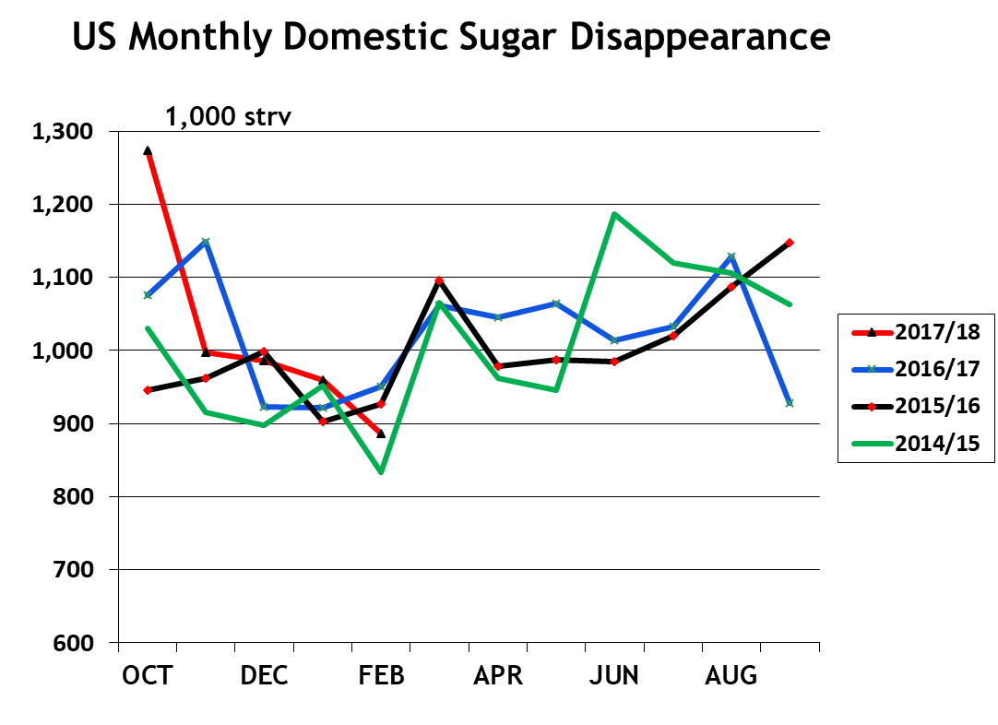
September deliveries disrupted by Irma

Slide 7
Mexican Overview
Mexican production now looks to be up only slightly from last year’s 5.96 mmt, but they will have no trouble filling their US quotas.
Exports to the US rose from 75,000 mt in Oct-Dec to 500,000 mt in Jan-Mar.
For the 6 months, sugar <92 pol is 74% of the total. To date 556,000 mt of that quality were produced.
World market exports have been negligible due to weak world market price.
Consumption of sugar & HFCS up about 1%.
Current FOB mill prices are 35 cents for refined and just below 30 cents for estandar.

Slide 8
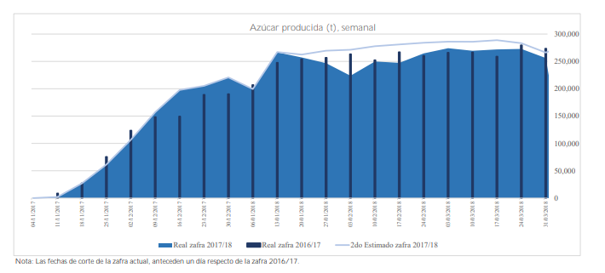
Production not meeting expectations
Mexico cut its forecast from 6.18 to 6.06 mmt in January but it looks like they will do well to hit 6.0.
This is reducing the need for world market exports.

Slide 10
